Slide 1
Scalable integrative bioinformatics with Bioconductor
VJ Carey
Channing Division of Network Medicine
Harvard Medical School

Slide 2
Scalable…
Makes effective use of resources available at run time
  Nodes/cores not left idle
  Disk/RAM use feasible and appropriate to task
  Management of operations and faults compatible with basic scientific computing effort/expertise. High level interfaces provided to support
    Job distribution, result collection
    Error recovery

Slide 3
integrative…
Immediate sense: uses information on multiple genome-scale assays on multiple samples
Deferred sense: results of analyses can be combined to formally test hypotheses of increasing breadth and depth

Slide 4
… with Bioconductor.
Immediate sense: uses software tools distributed at bioconductor.org
  plus CRAN, plus boost, plus other components
  plus a pre-configured VM usable with Amazon EC2
Deferred sense: employs strategies for data structure and algorithm deployment that are shared among packages to enhance user and developer experiences
  R packages with continuous integration
  Formal object designs using S4, reference classes, abstract data types

Slide 5
Why a part of workshop at ISMB?
Data and algorithms emerging rapidly
Environments for computing are diverse and evolving
Complexity in the subject matter and the interface
  We want to subdue the interface complexity to maximize effort available for scientific interpretation

Slide 6
Use case: identification of cis-dsQTL
Resources:
  1.5 million DnaseI hypersensitivity scores on 70 individuals from YRI HapMap cell lines
  20 million SNP genotype calls from 1000 genomes phase 1
Aim: for every SNP within a given ‘radius’ around each DHS, obtain the FDR for H_{o}: mean DHS score independent of SNP content
  Use an additive genetic model

Slide 7
Why?

Slide 8
Bridging to structural and functional annotation

Slide 9
Summary
Genetics of variation in DnaseI hypersensitivity should illuminate mechanisms of expression regulation
dsQTL seen to be related to GWAS hits
High volume (100x transcriptome?) problem with complicated upstream filtering, potential sensitivity to tuning

Slide 10
Overview of approach
Step 1: establish data structures suitable to scalable integrative analysis, adhering to bioc conventions on self-description, configurable yield
Step 2: build a cluster of machines with efficient access to the data
  DHS: in an R package
  Genotypes: in VCF in S3 bucket
Step 3: create a function F that obtains and annotates the required statistics for any slice of the genome
Steps 4-6: define the genome slices relevant for the solution and map them to tasks based on F in a BatchJobs registry
Steps 7-8: submit tasks to scheduler, collect and amalgamate

Slide 11
Step 1: Data structure definition: 1a: SummarizedExperiment for DHS scores
Package dsQTL: import DnaseI hypersensitivty scores from BED files at GEO GSE 31388
  rtracklayer used to import and convert from hg18 to hg19 addressing
  SummarizedExperiment container used

Slide 12
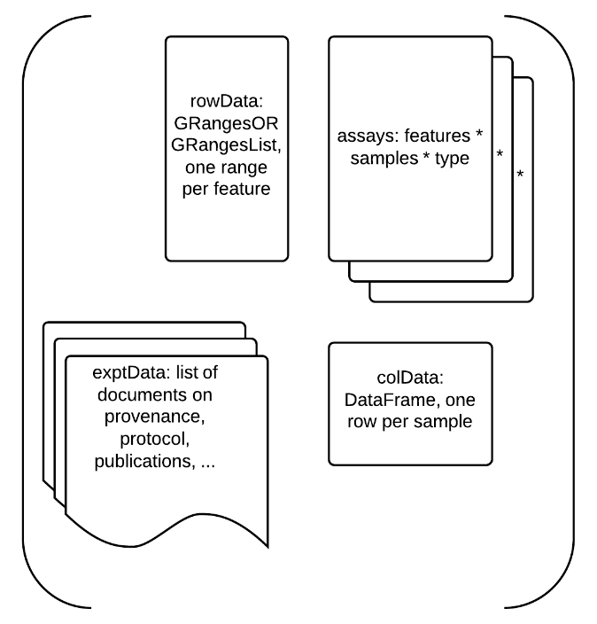
Key components of SummarizedExperiment instances -- rowData : P ranges; assays : P x N, colData : N x R

Slide 13
Step 1b: TabixFile for 1000 genomes VCFs in Amazon S3 bucket
We will demonstrate the search using the Bioconductor custom AMI
We can transfer data from URLs such as http://1000genomes.s3.amazonaws.com/release/20110521/ALL.chr8.phase1_release_v3.20101123.snps_indels_svs.genotypes.vcf.gz to the AMI with no data transfer expense (as of 11 July 2014)

Slide 14
Poking around in the bucket

Slide 15
deeper…

Slide 16
Step 2: Build a cluster of AMIs
Use starcluster, for example, as extensively documented at http://www.bioconductor.org/help/bioconductor-cloud-ami/#using_cluster
The endowments of the nodes
  Number of cores
  Available RAM
  will determine the approach to problem decomposition and solution. You will generally have to experiment to understand how your programs consume resources.
For our example, we use BatchJobs with Sun Grid Engine to control use of resources

Slide 17
Step 3: Define a function that solves the problem completely for the containers/interface in use
For this example, the GGtools function cisAssoc is the core
  Inputs are a SummarizedExperiment instance, a TabixFile (reference), and a specification of the search radius
  Output is a GRanges instance recording, for each feature in the SummarizedExperiment, the observed association scores for all SNP within the search radius, plus scores obtained after permutation of DHS results against genotype … for plug-in FDR
  Because the genotype data are provided by chromosome, some additional tailoring is present to match DHS features to available genotypes
Iteration over independent tasks within cisAssoc are coded using foreach to allow low-level parallelization when, e.g., multiple cores are registered, but this does not occur under SGE
  SGE “orte” environment is used and each core is regarded as a “slot” to receive a job

Slide 18
Step 4: Define a partition of the problem into jobs that can be handled independently by top-level cluster elements
SummarizedExperiment instances obey the X[G,S] idiom familiar from microarray ExpressionSet programming
  Integer vectors as G define a restriction on assays
  The restriction is propagated to the rowData GRanges
  scanVcfParam can filter samples and loci on access, so the query for genotypes is determined by elements (colnames, rowData) of the restriction of SummarizedExperiment

Slide 19
Step 5: Create a BatchJobs registry to control processing
Defines a folder where task outputs are stored, and a SQLite database with information on task-set progress
Defines R environment/packages to be attached as tasks start
Maintains information on job initiation and conclusion
Provides an interface to targeted result collection and recovery

Slide 20
Step 6: Map the elements of the task partition to the registry
batchMap(reg, fun, …, more.args)
‘…’ defines the partition, so that when jobs are submitted, fun is scheduled for evaluation on each element of … on a cluster node that is running a specified R workspace
Registry can be serialized for interactive interrogation from any R session

Slide 21
Step 7: Submit jobs ad libitum
Can submit a few to check throughput
Continue from previous collection
Resubmit, reset problematic tasks

Slide 22
Step 8: collect and amalgamate results
loadResults will return a list with one element per task (output of F)
reduceResults(reg, ids, part = NA_character_, fun, init, impute.val, ...)will perform programmatic aggregation
  fun has form function(aggr, job, res, ...), where aggr is current accumulation, job is an identifier, and res is the current output to be aggregated

Slide 23
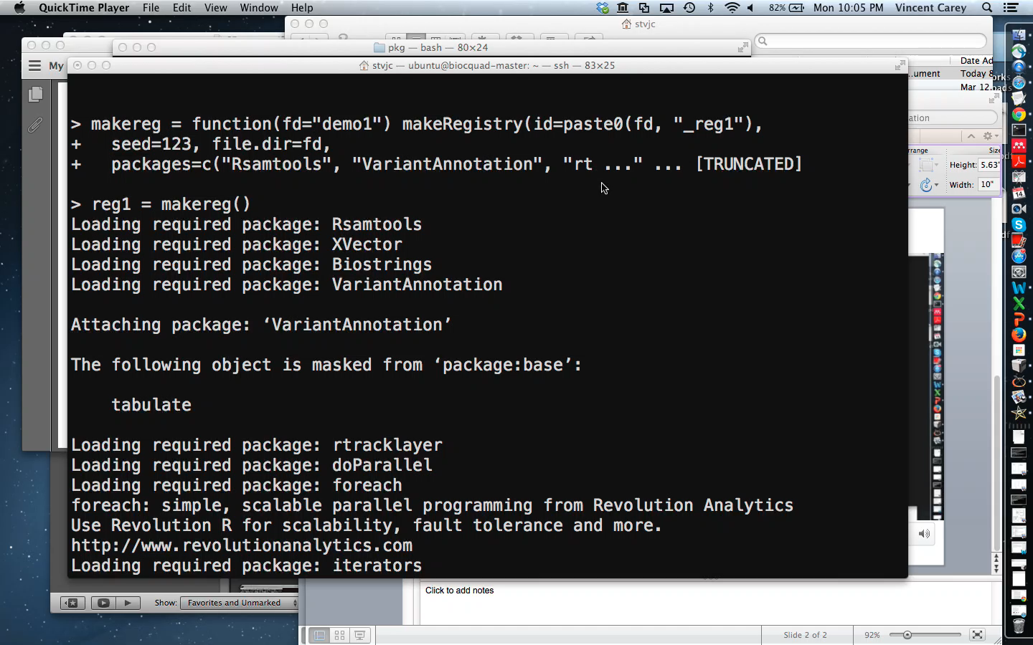
Create registries, two chunk sets (250/500 DHS), map 40x250, 20x500, submit, check queue, check memory footprint (58sec video)

Slide 24
Outputs after initial submission

Slide 25
Data on task execution

Slide 26
Estimating ranges per second for two chunk sizes

Slide 27
Conclusions
Bioconductor AMI is a good exemplar for VMs encapsulating research infrastructure
Starcluster + SGE + BatchJobs manage cluster and task processing conveniently; simple performance analysis easy with BatchJobs
Amazon S3 buckets provide free transmission of massive data; Rsamtools/VariantAnnotation permit scalable querying of 1000 genomes
Strategies translate to locally managed clusters and clouds

